Slide 1
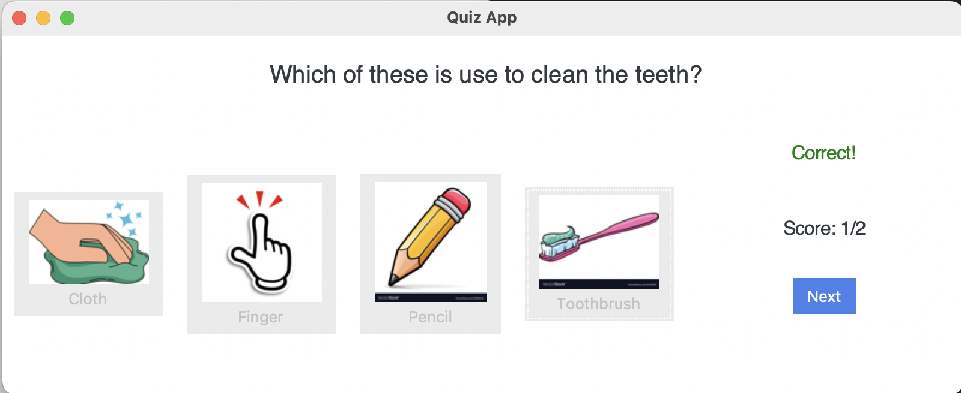
GiggleGums
The Ultimate Transformative Game in Pediatric Dental Education!
By:
Dipti Paldhikar
Divya Mamtora
Khushbuben Patel
Saiyida Jabeen

